Slide 1
Super widefield particle tracking in near real-time via image stitching
Sean MacKenzie, Rami Dabit, Peter Li
ECE 278A

Slide 2
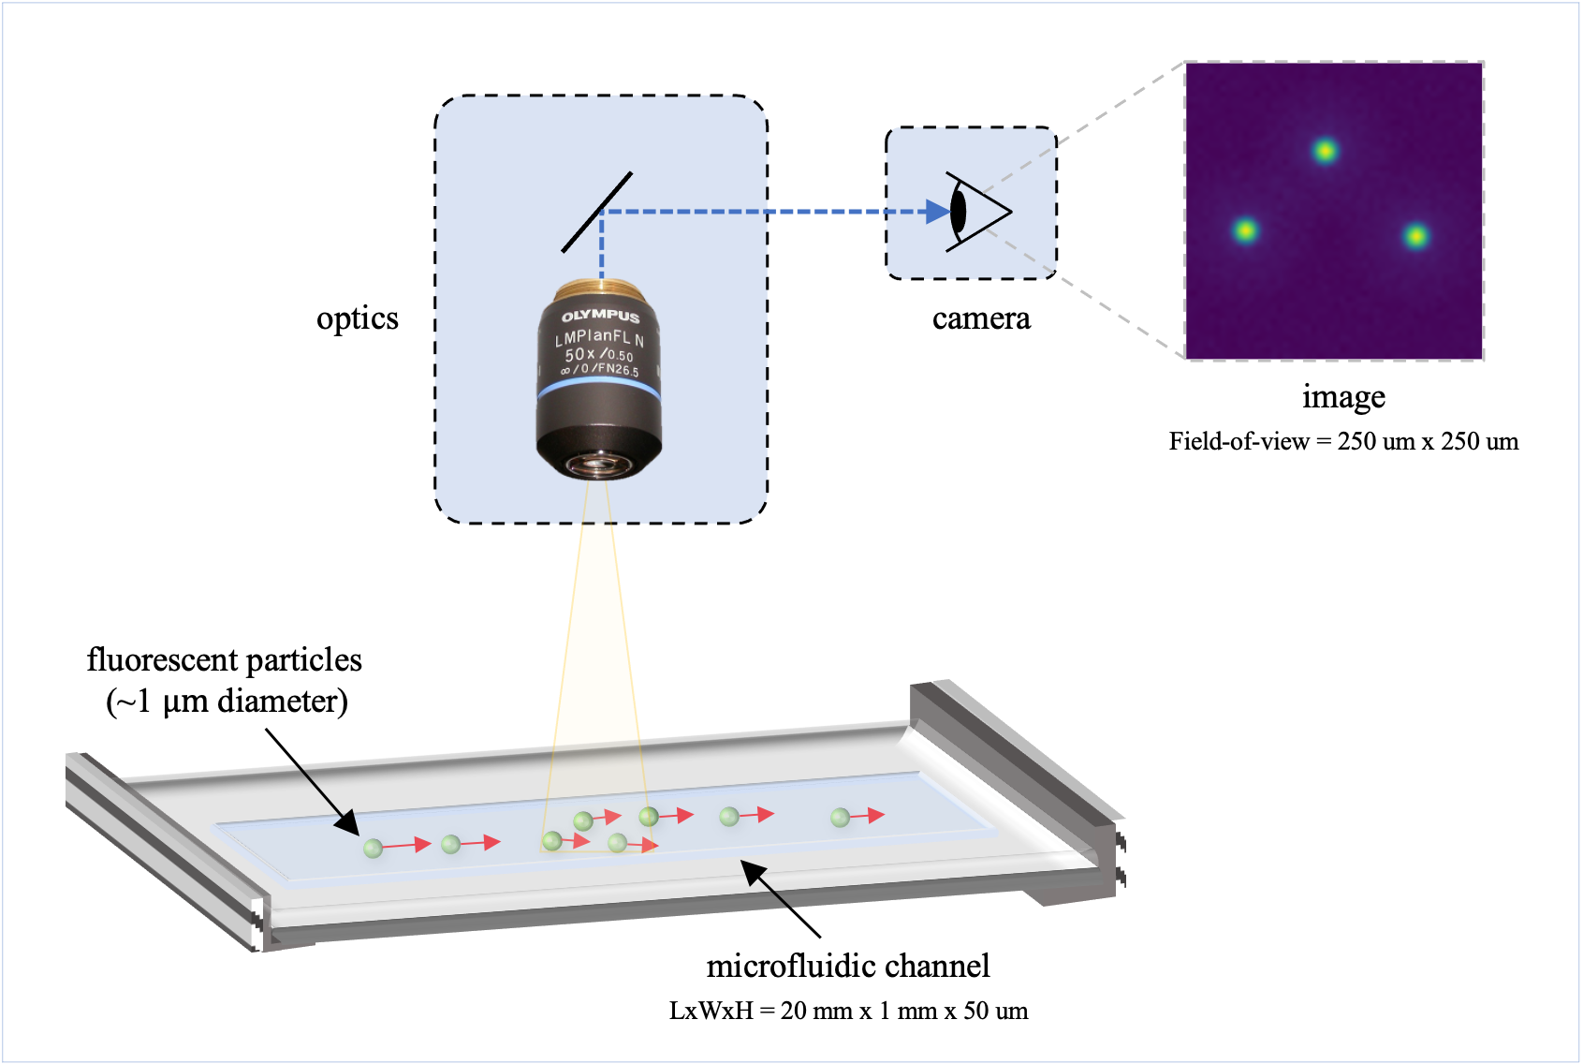
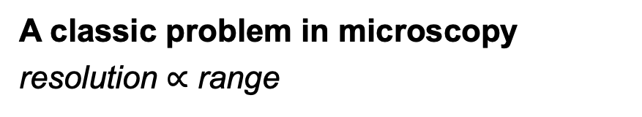
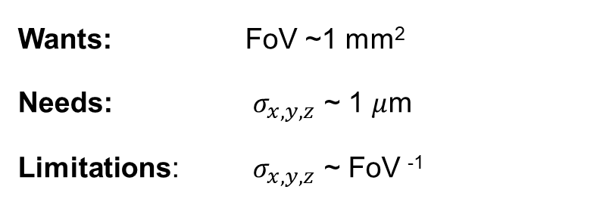
Introduction
Presenter: Sean
Application: Microfluidic Particle Tracking
A classic problem in microscopy
resolution $∝$ range
For example, for 20X magnification:
Field-of-view (FoV; i.e. range) is ~250 um².
spatial (x, y, z) resolution is ~ FoV / 100.
Wants: FoV ~1 mm²
Needs: $σ_{x, y, z}$ ~ 1 $μ$m
Limitations: $σ_{x, y, z}$ ~ FoV ⁻¹
Notes:
Currently, this requires performing multiple experiments where each local region-of-interest is separately observed.
This has a significant drawback:
experimental conditions can vary unpredictably and uncontrollable, lowering experiment repeatability and confidence.

Slide 3
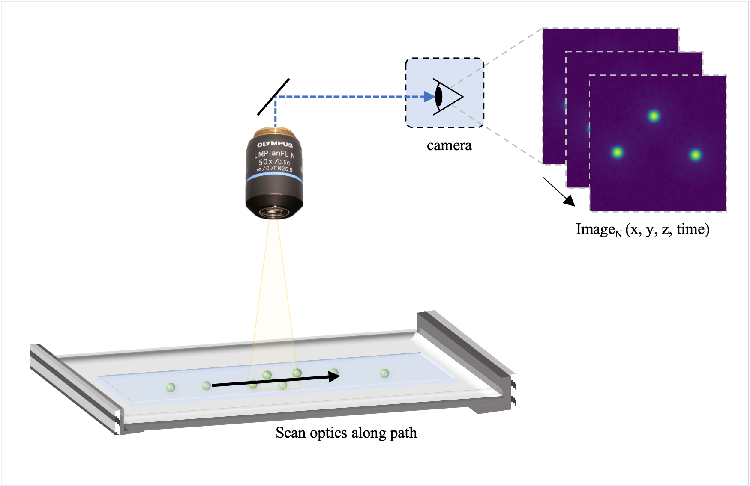
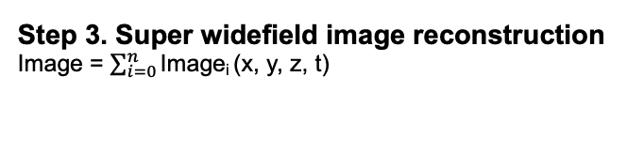
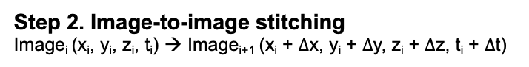
Super widefield imaging via image stitching
Presenter: Sean
Step 1. Image Acquisition
Image_{N} (x, y, z, time)
Image_{i}
Image_{i+1}
Image_{i+2}
Step 2. Image-to-image stitching
Image_{i} (x_{i}, y_{i}, z_{i}, t_{i}) → Image_{i+1} (x_{i} + $∆$x, y_{i} + $∆$y, z_{i} + $∆$z, t_{i} + $∆$t)
Step 3. Super widefield image reconstruction
Image = $\sum_{i=0}^{n}{\text{I}\text{mage}\text{i} \text{(}\text{x}\text{, }\text{y}\text{, }\text{z}\text{, }\text{t}\text{) }}$

Slide 4
Methods – Dataset
Presenter: Sean
Dataset #1
Dataset #2
Synthetic particle images
Access to ground truth.
Standardized dataset.¹
Widely used.²
i
Investigate: Percent image ovlerap
% overlap
50%
25%
j
[1] M. Rossi, (2020)
[2] Pennathur Lab, Dept. of Mechanical Enginerring, UCSB
Image for 1D stitching
Widefield image for 2D stitching

Slide 5
Methods – Image Stitching
Presenter: Rami
Feature Detection
Laplacian of Gaussian (LoG)
Difference of Gaussian (DoG)
Determinant of Hessian (DoH)
Keypoint Preselection
Common approaches
Our algorithm
Keypoint Matching
SSD minimization
Image Stitching
Post-processing Bundle Adjustment

Slide 6
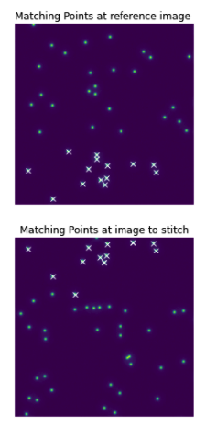

2. Keypoint Selection
Presenter: Rami
(1) Manually define # of key points
Common approaches:
Manually define # of key points
RANSAC
Least Median of Squares (LMS)
In our algorithm:
Challenge: Keypoints look very similar
Sort the keypoints based on y-position
Choose a few keypoints from upper
Choose a few keypoints from lower
Feature matching (SSD Minimization)
key points = 14
Image_{i}
matching points:
un-matched points:
25 $μ$m
Image_{i+1}

Slide 7
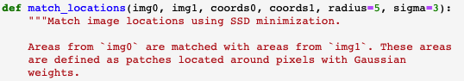
3. Keypoint Matching – SSD Minimization
Presenter: Peter
image_{i}
(img0)
Routine:
For key point₁ in image_{i} (img0)
Find the nearest key point in image_{i+1} (img1)
Calculate the pixel-wise “distance”:
Evaluate the Gaussian-weighted sum of squared difference over a pixel neighborhood (e.g. 11x11 pixels)
Return the pixel with the smallest distance.
Repeat for all key points_{1…N}
image_{i+1}
(img1)

Slide 8
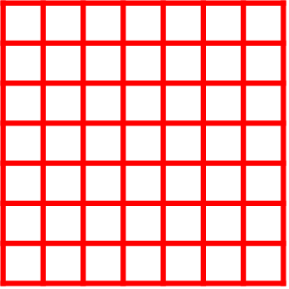
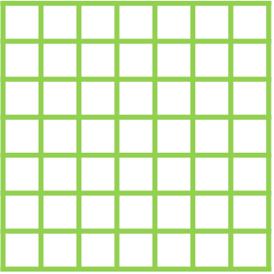
3. Keypoint Matching – SSD Minimization
Presenter: Peter
image_{i}
(img0)
1st step: compute diff matrix
point₁ at img1
Gaussian-weighted matrix
point₁ at img0
(radius=2 at the example)
center
radius
(
)
-
x
2*radius + 1
image_{i+1}
(img1)
point-wise product
2nd step: compute sum of elements in diff matrix

Slide 9
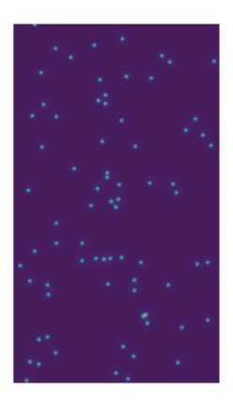
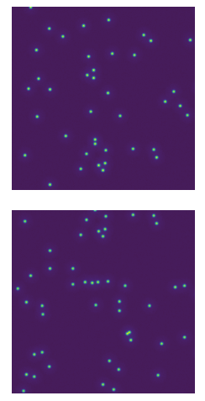
Algorithm Mechanism
Presenter: Peter
Update input images
Use detector to extract positions of the particles.
Update the # of key points
Obtain matching points by SSD minimization
Use matching points
to stitch images.
Start

Slide 10
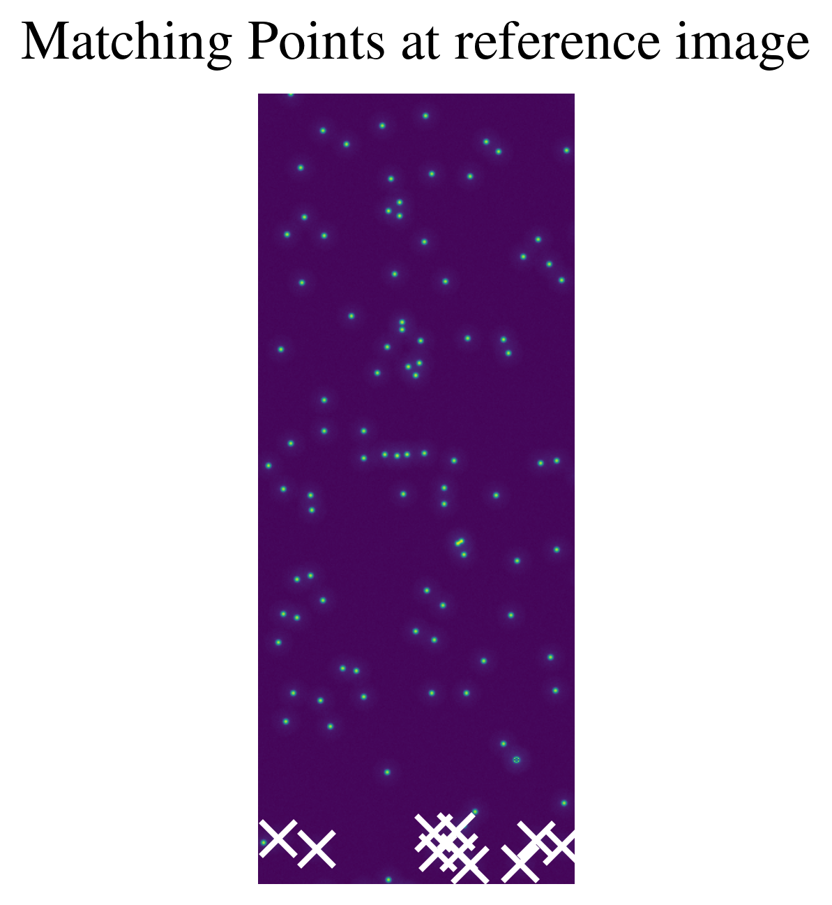
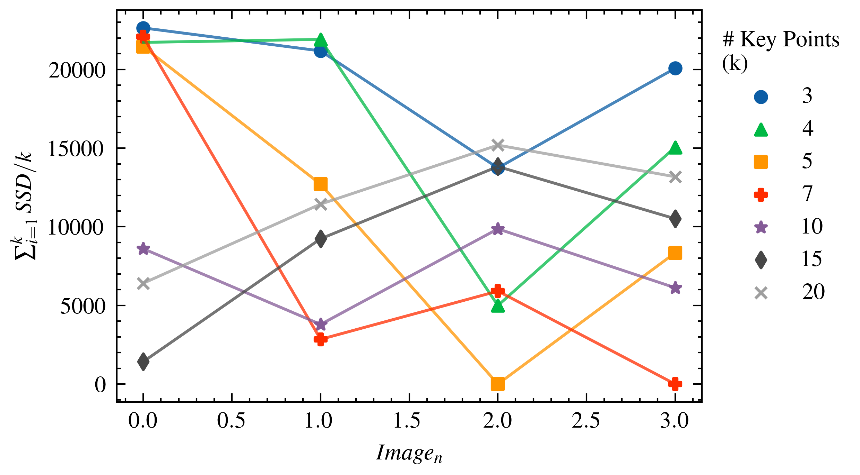
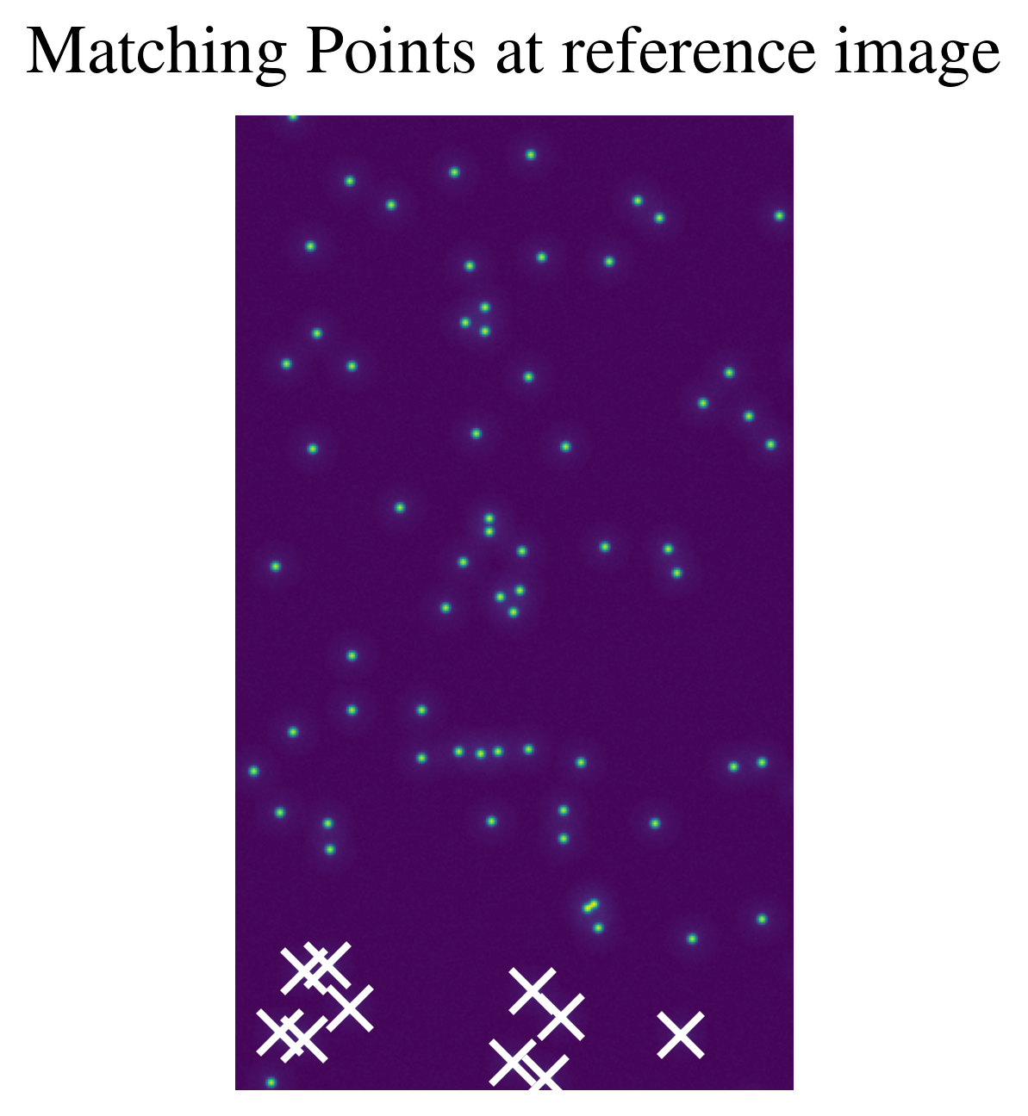
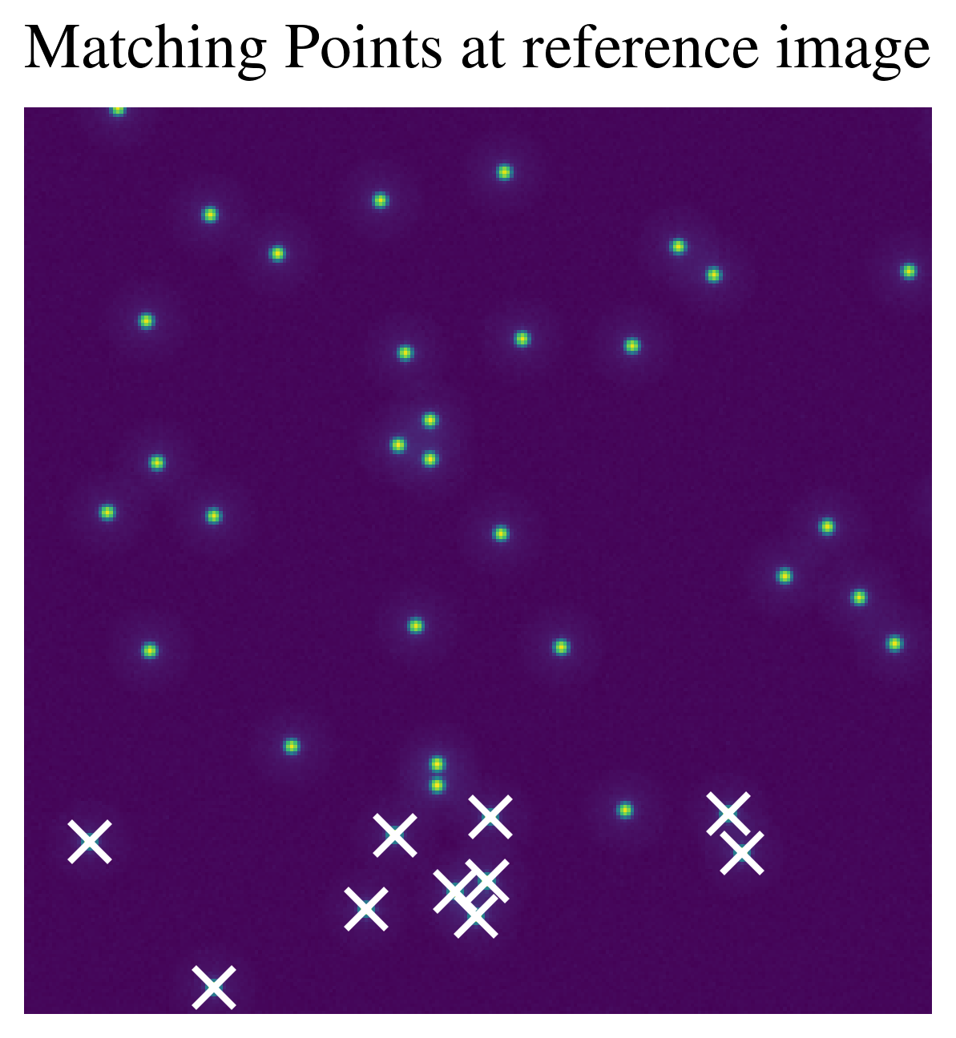
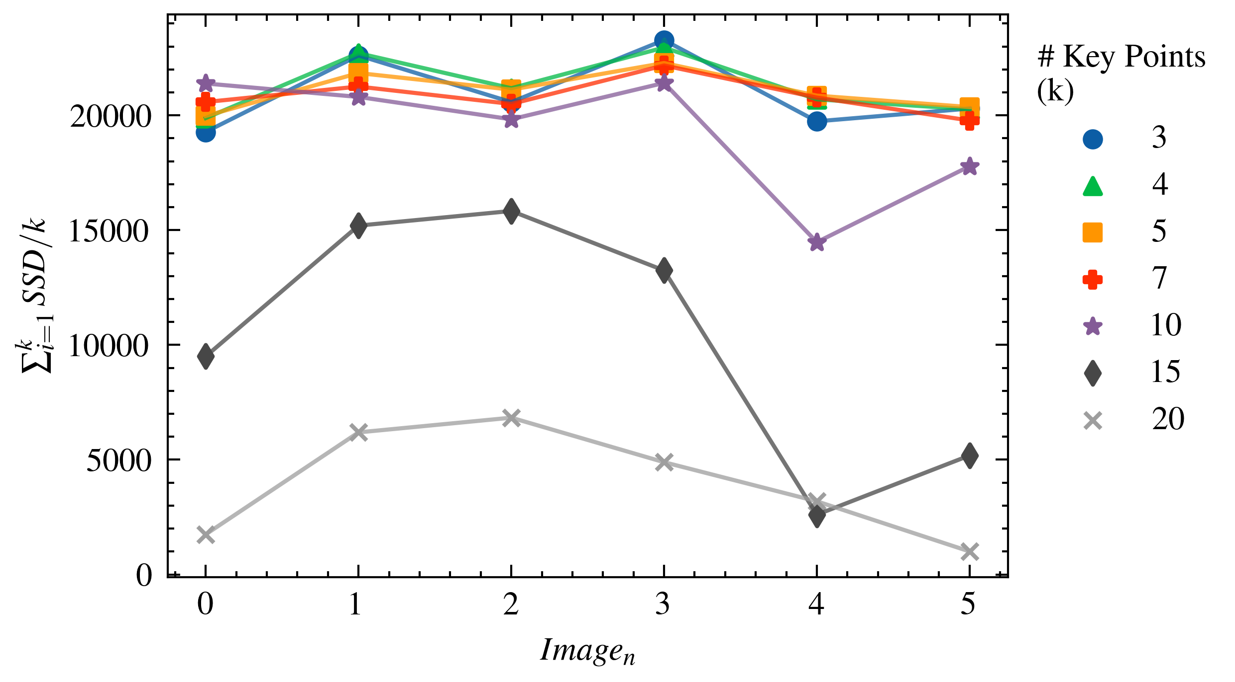
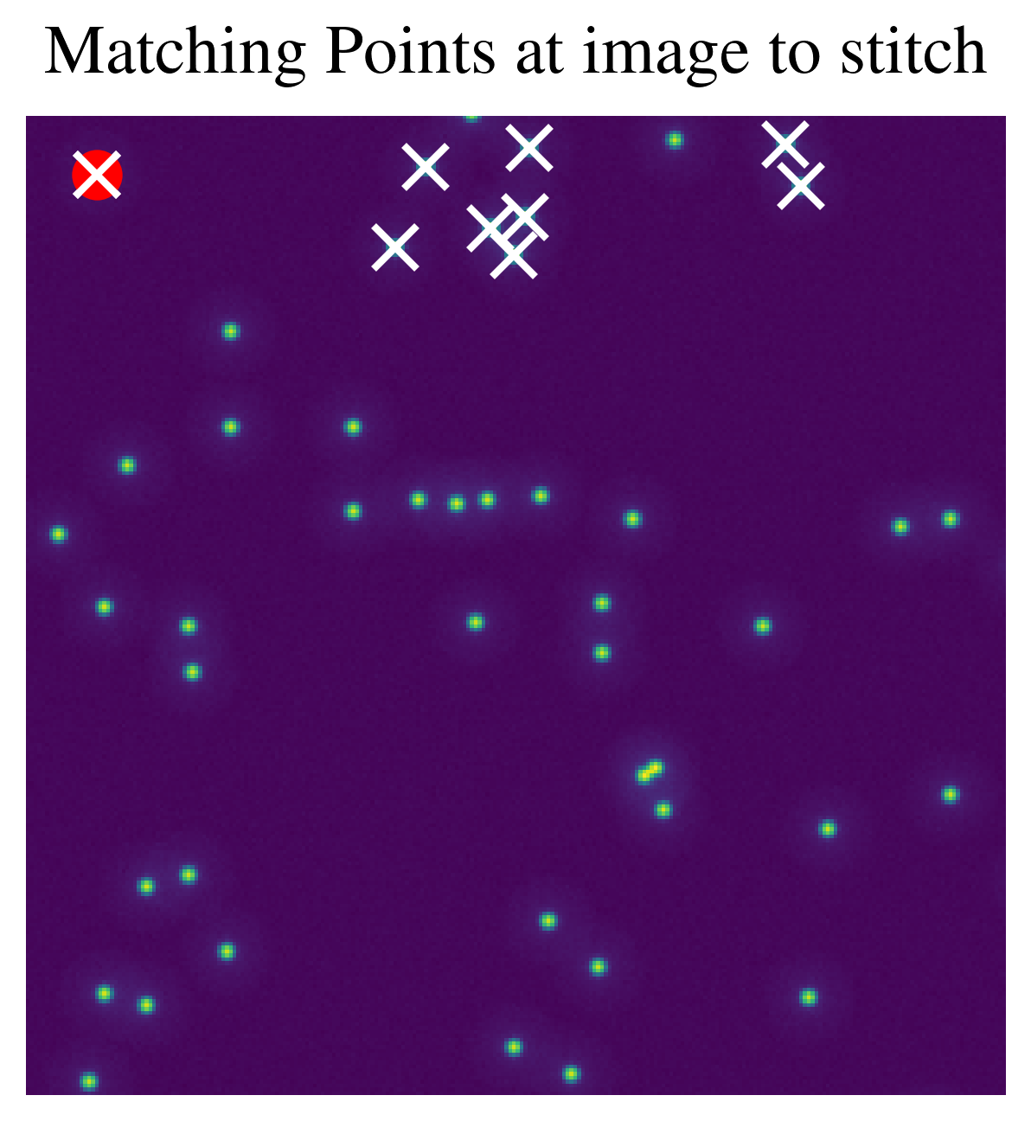
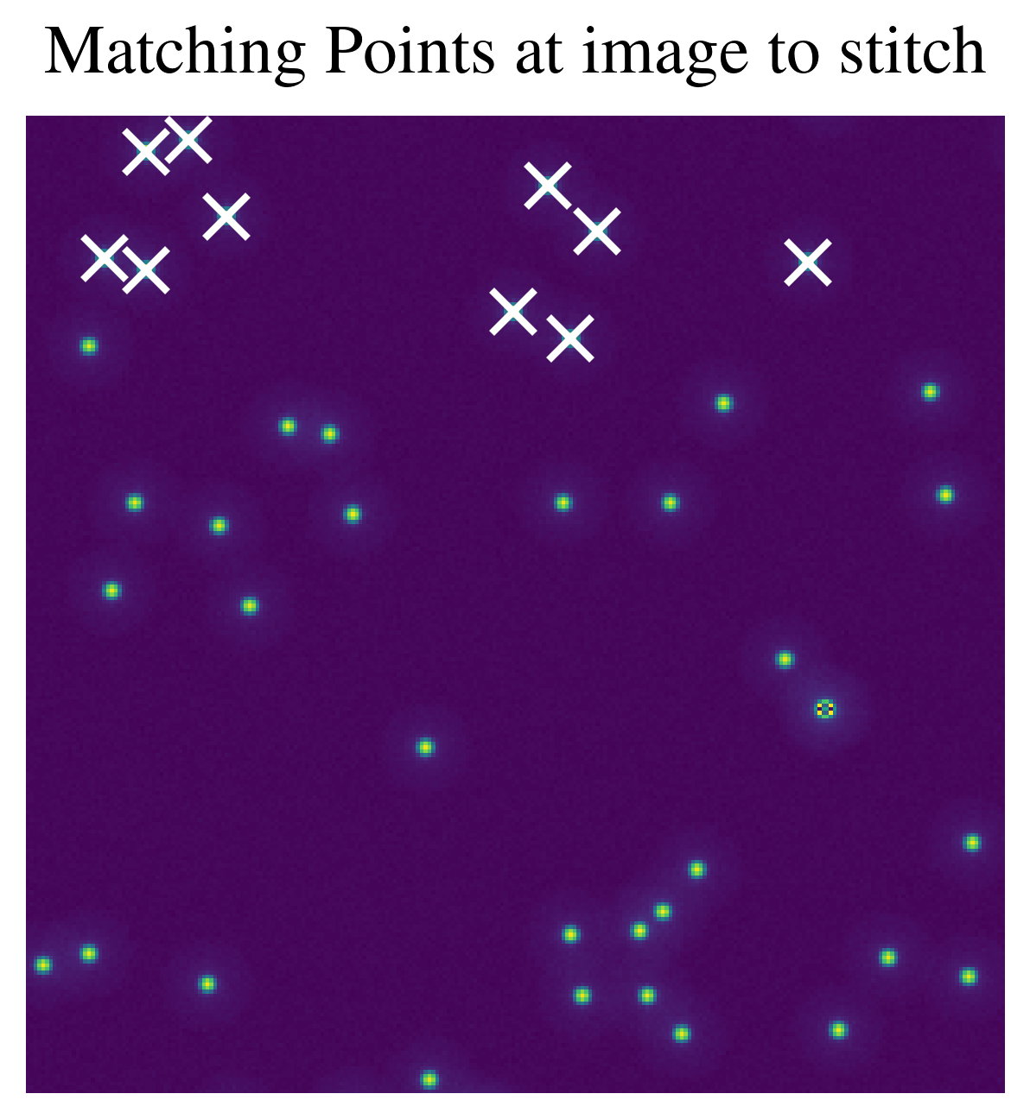
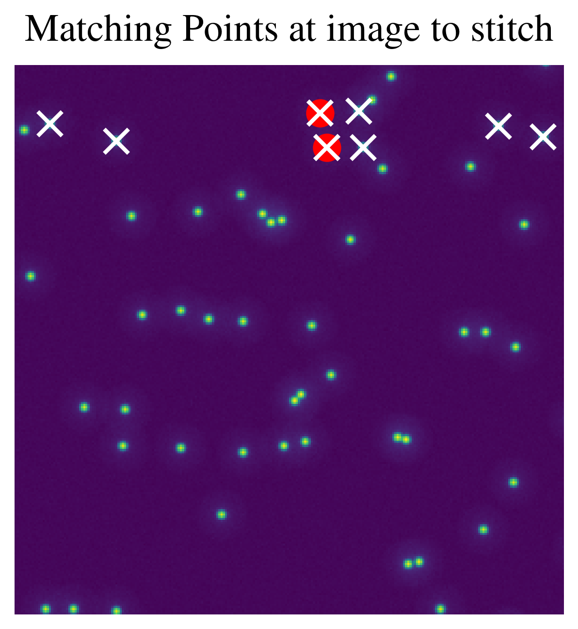
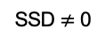
Results – Number of Key Points
Presenter: Sean
Continuous image stitching
25%
image overlap
Matching Image
50%
image overlap
Reference Image
X
Identified key point
Image_{N}
X
SSD $≠$ 0

Slide 11
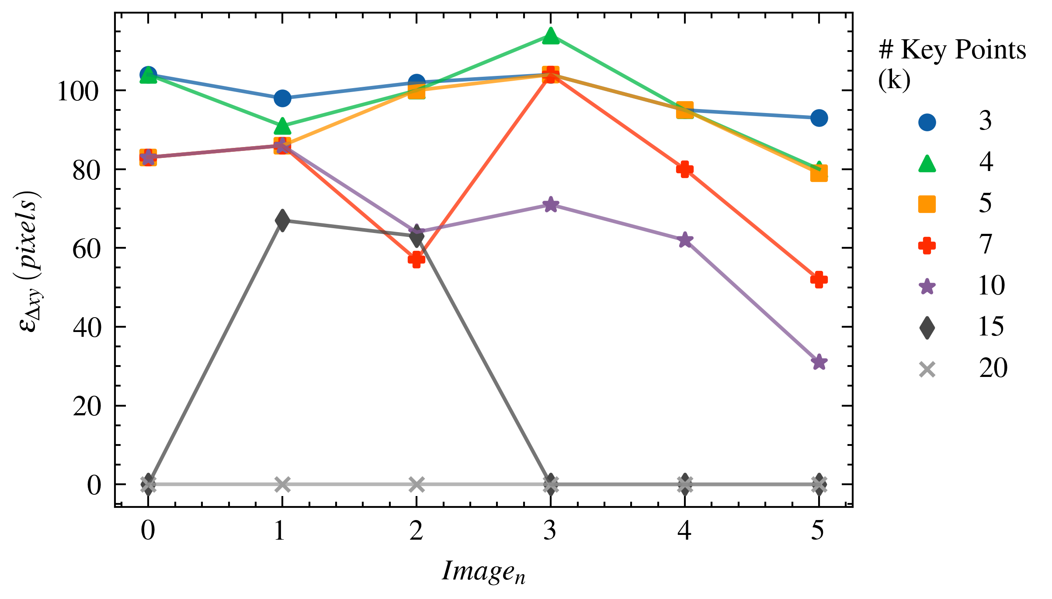
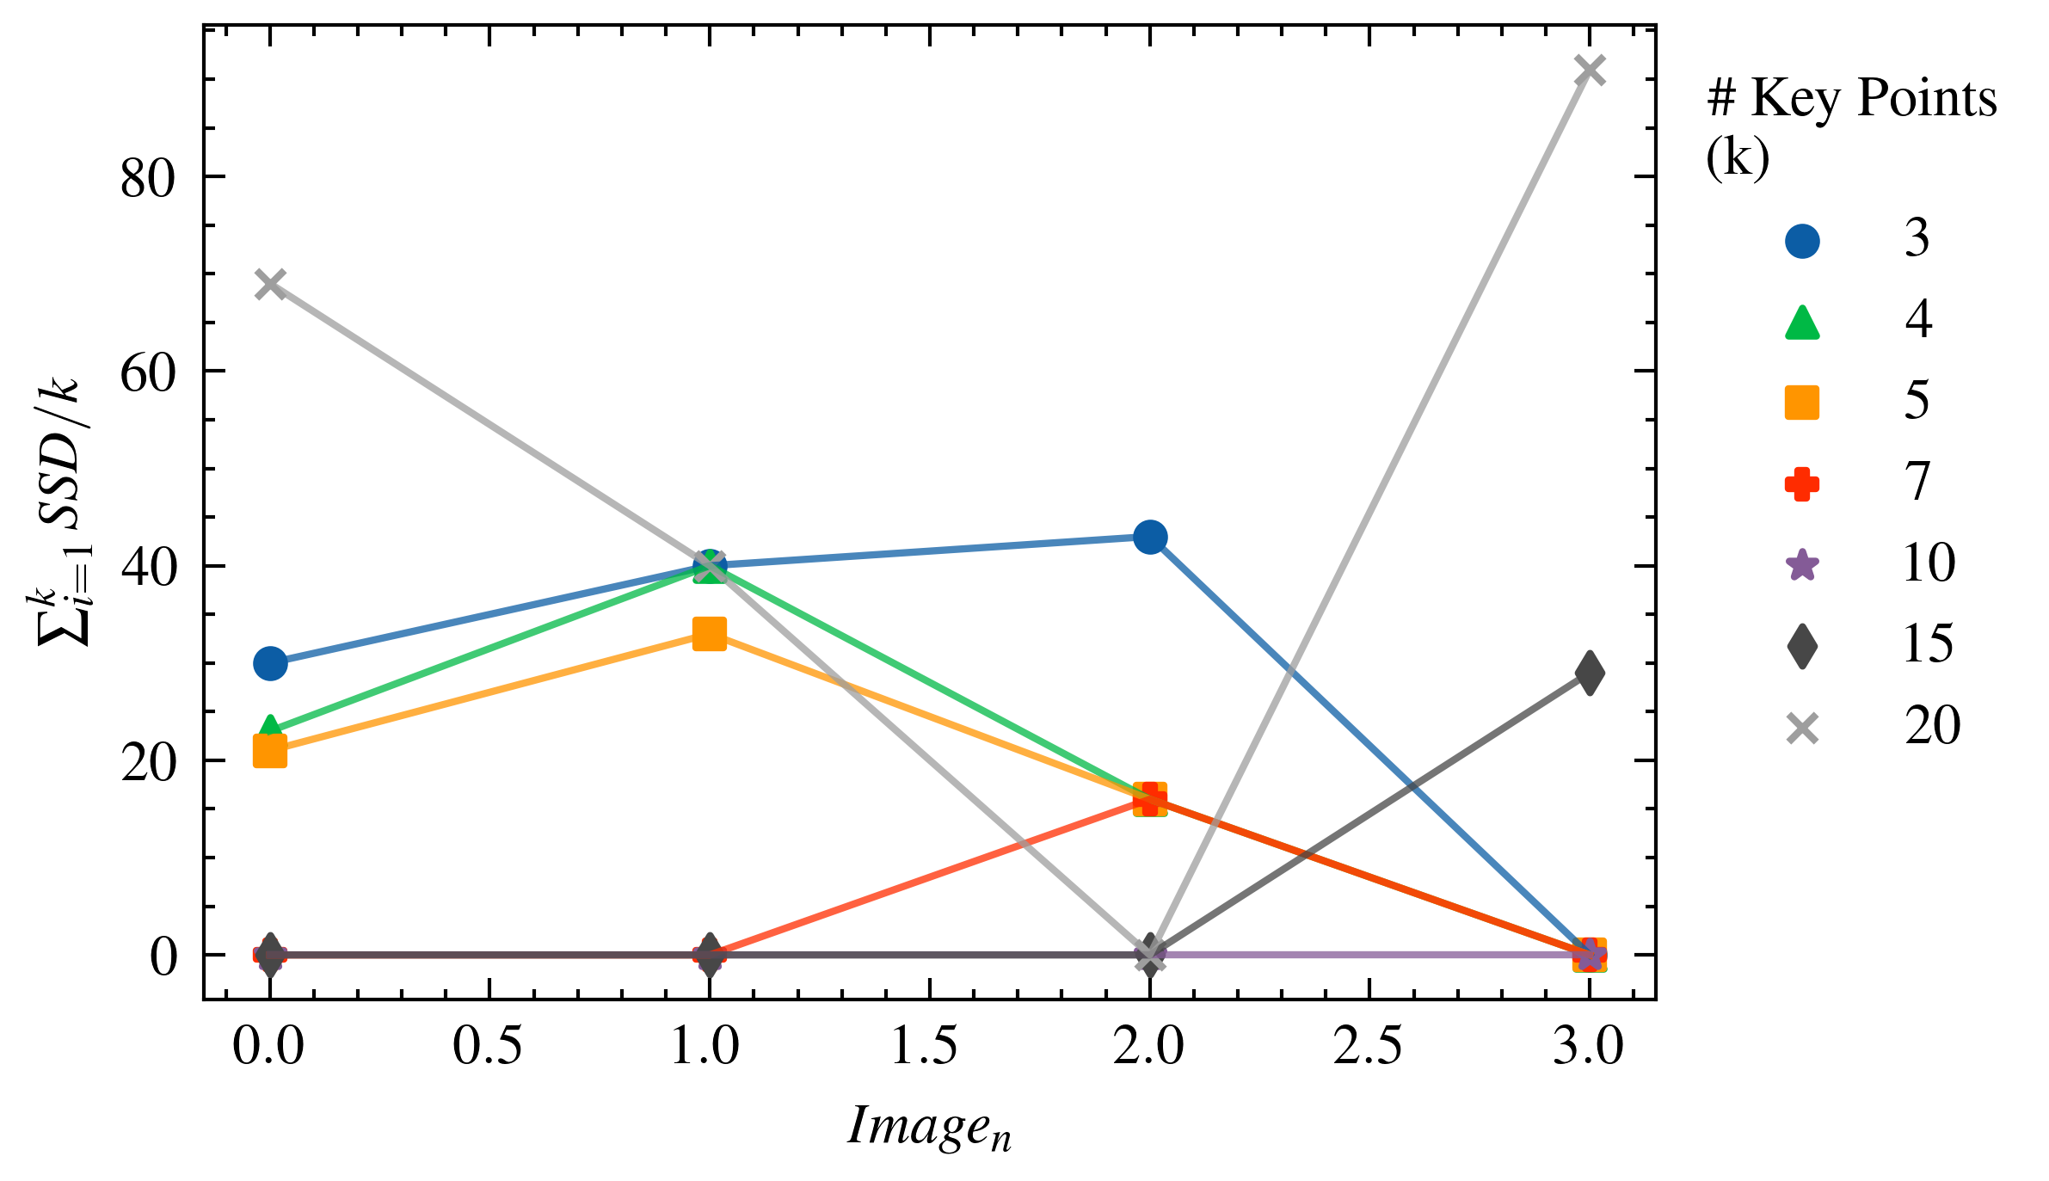
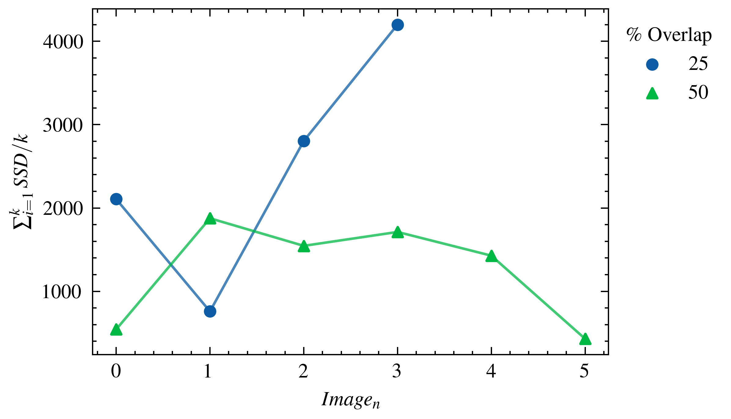
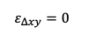
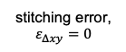
Results – Percent Image Overlap
Presenter: Sean
1. Identified two “best” stitching implementations.
2. Evaluated super widefield 2D stitching accuracy for 25% and 50% image overlap.
25%
image overlap
stitching error,
$$ε_{Δxy}=0$$
50%
image overlap
$$ε_{Δxy}=0$$

Slide 12
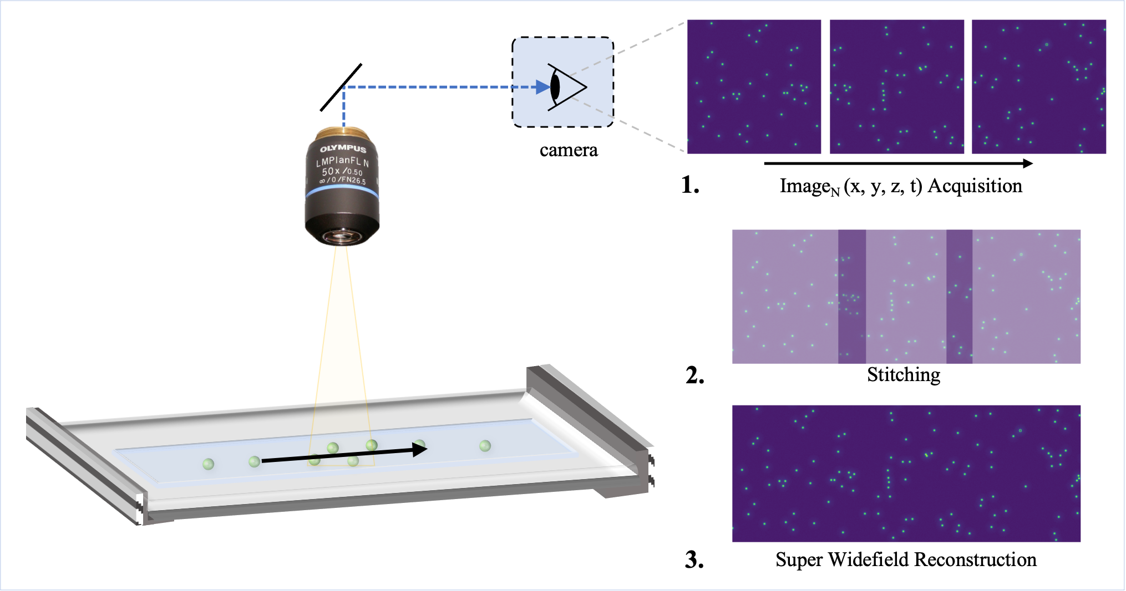
Conclusion
Presenter: Sean
Key Takeaways:
Evaluating pointwise matching accuracy is not necessarily indicative of image stitching accuracy.
→ Example: 25% overlap with DoH with 10 key points had lower matching accuracy but perfect stitching accuracy.
Increasing the # of key points generally increases accuracy.
Example: 25% overlap with DoH with 10 key points.
Increasing the image overlap generally increases the accuracy.
But perfect stitching was demonstrated at 25% overlap.
Enables faster scanning of super widefield area.

Slide 13
Thank you! Questions?

Slide 15
Supplementary Information

Slide 16
Outline
Introduction + Background
microscopes are limited by field-of-view
Solution
stitching images together to capture a widefield
Methods
Feature Detection
Difference of Gaussian (DoG), Determinant of Hessian (DoH), Corner Harris
Keypoint Preselection
Manual Input
Matching
Custom Gaussian Weighted SSD
Stitching
Post-processing Bundle Adjustment
Results and Discussion
Number of Key Points
Percent Image Overlap
Conclusion

Slide 17
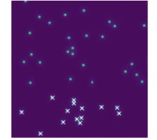

Stitching Function Principle
$$\hat{offset}=\underset{offset}{argmin}{\sum_{\begin{aligned}matching point i \\ at img0 \end{aligned}}{ \sum_{\begin{aligned}matching point j \\ at img1 \end{aligned}}{distance(P_{i},P_{j})}}}$$
offset
In this example, offset increases from 0 to 256.

Slide 18
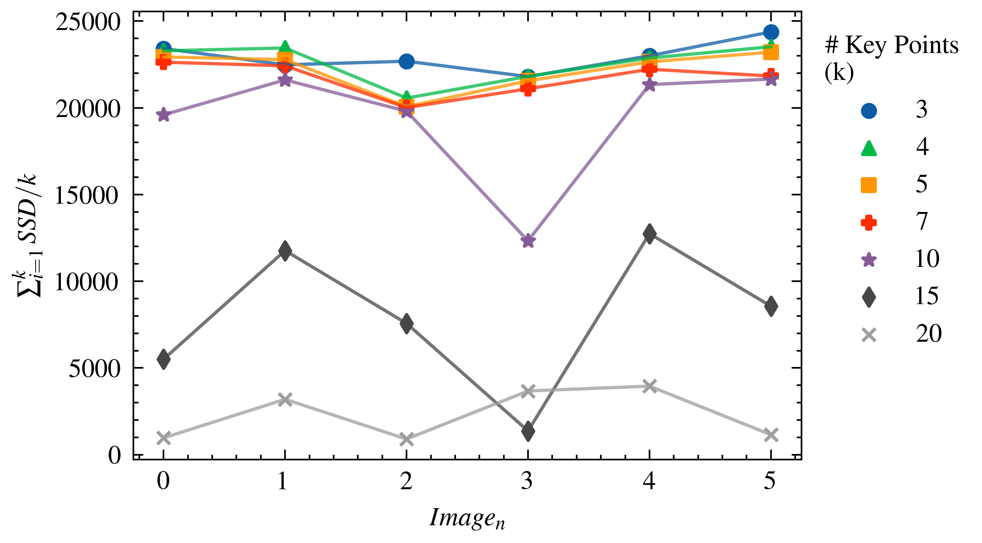
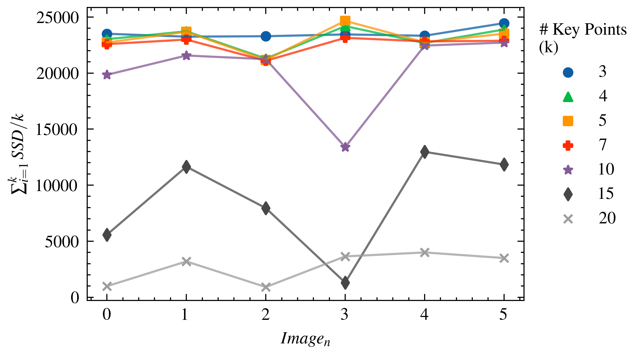
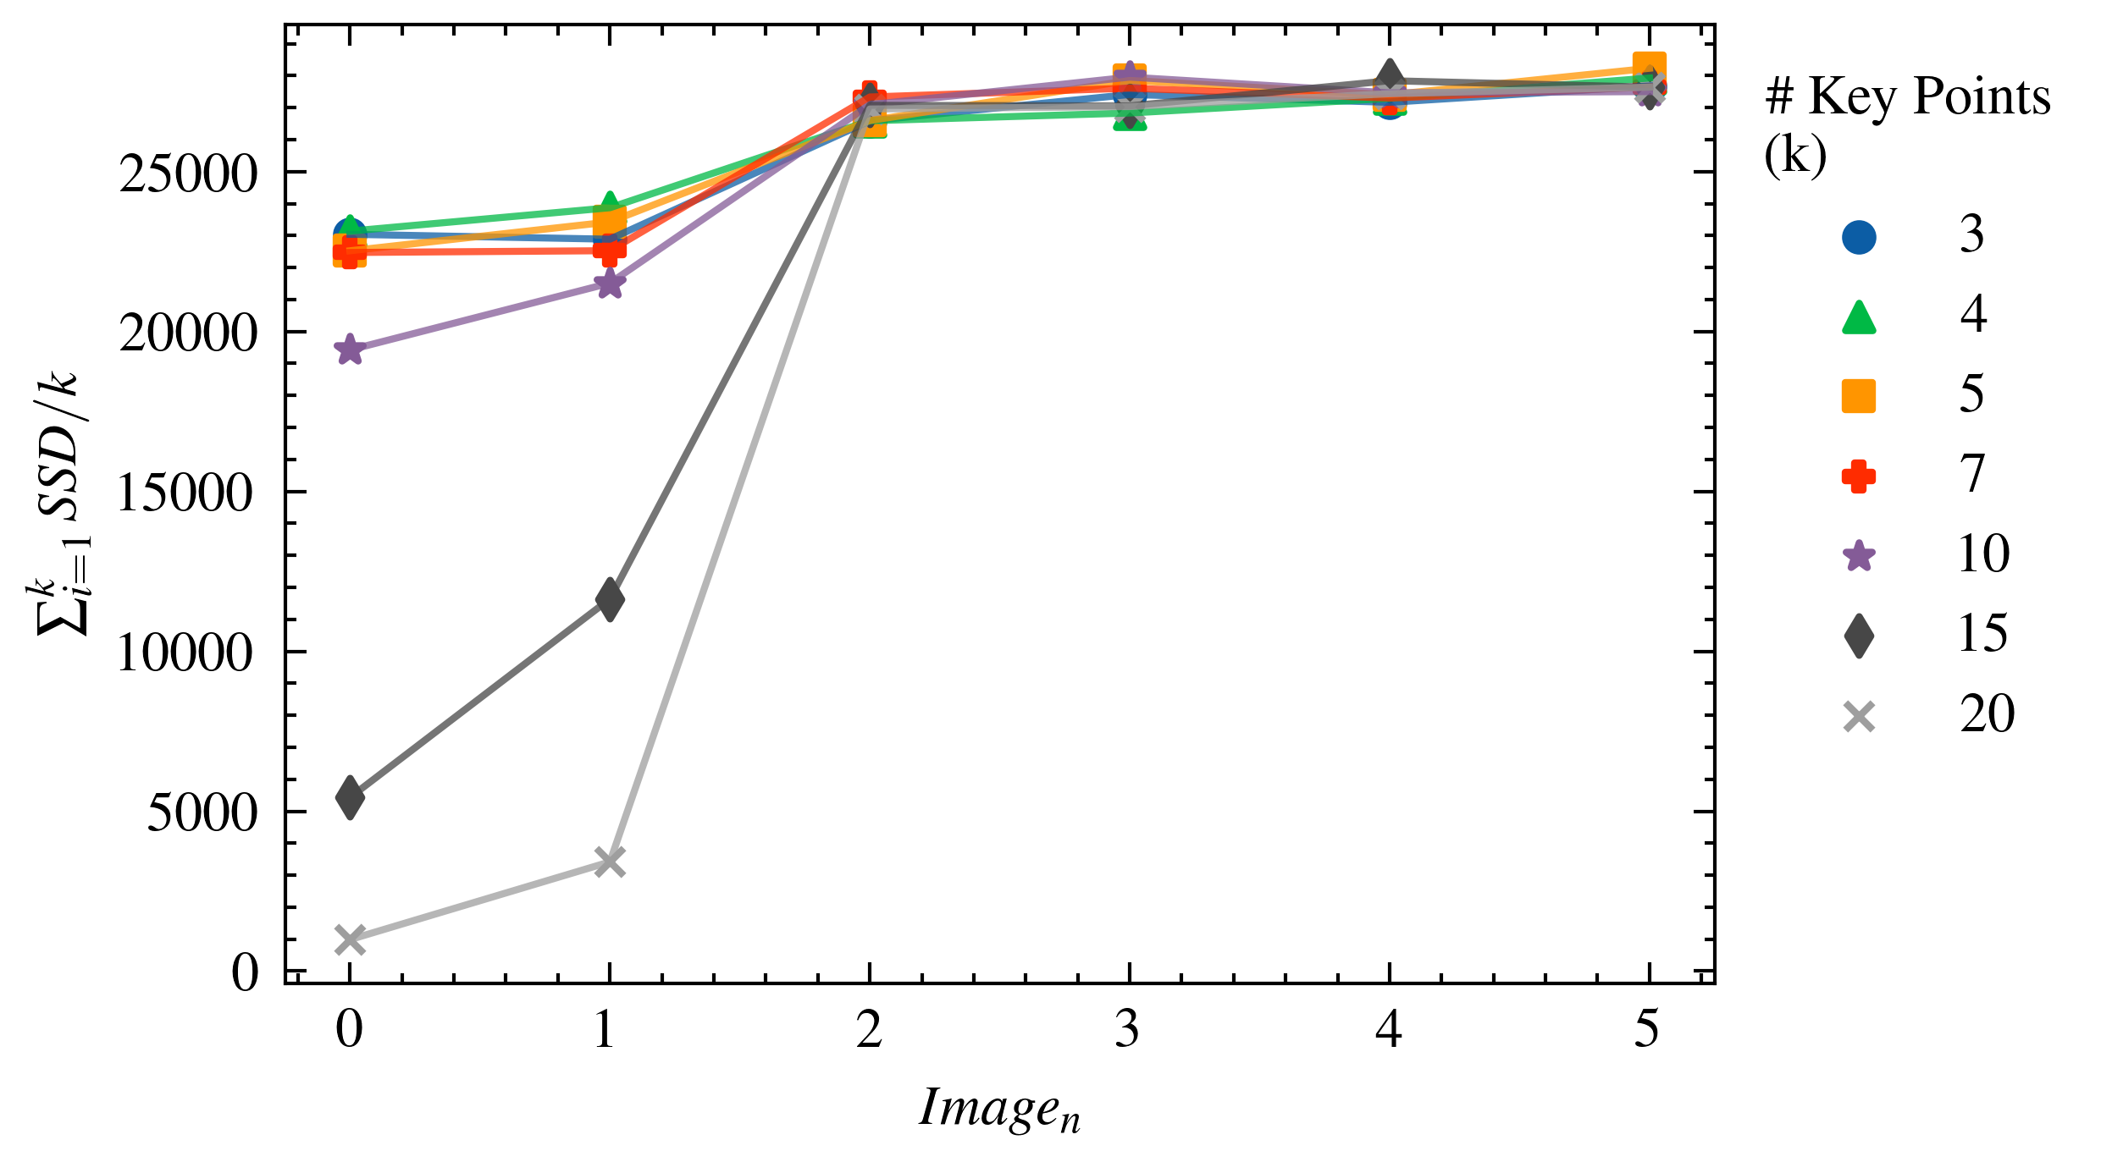
Feature Detection Method
Difference of Gaussians (DoG)
Harris Corner Detector
Determinant of Hessian (DoH)

Slide 19
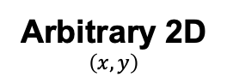
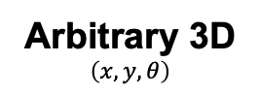
Future Directions
Present Work
Future Work
Vertical
Horizontal
Arbitrary 2D
$$\left(x, y\right)$$
Arbitrary 3D
$$\left(x, y, θ\right)$$

Slide 20
Evaluation Metrics
Metric | Variable Name | Description
Ground Truth | true_image_length | The ground truth image length.
 | true_image_width | The ground truth image width.
 | true_percent_overlap | The percent overlap of the synthetically generated images.
 | true_shift | The pixel shift described by the true percent overlap.
Inputs | input_direction | The direction of the image stitching (e.g., horizontal or vertical)
 | input_detector | The key point detector (e.g., Difference of Gaussians)
 | input_num_keypoints | The number of key points used for image stitching.
 | input_min_distance | The minimum distance (in pixels) allowable for some key point detectors.
Outputs | image_number | The image number along a stitching path where 0 is the first image.
 | num_keypoints_detected | The number of key points detected in the image.
 | num_keypoints_matching | The number of key points used for image stitchings (dependent on detection).
 | sum_ssd | The sum of the sum squared difference over all matching points between two images.
 | calc_shift | The calculated shift to stitch two images together.
 | calc_diff | A quantitative metric of the image stitching error (note: not used for evaluation).
 | calc_image_length | The reconstructed image length.
 | calc_image_width | The reconstructed image width.

